Slide 1

ANB B2B API Transactions Banking Solutions

Slide 2
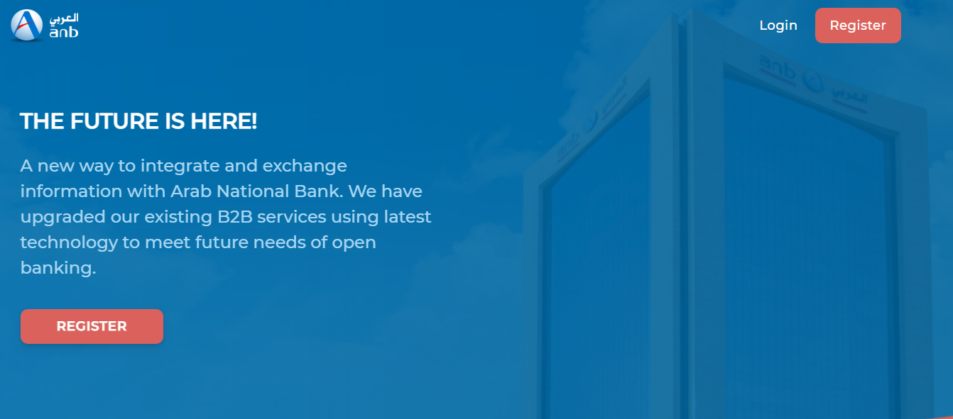

Slide 3
What is B2B?
ANB B2B is a solution for companies who in need to establish a direct connection over the internet from their accounting systems/ERPs to ANB’s backend system for accessing information as well as processing transactions with the highest international security standards.
B2B solution is designed for companies that requires direct integration/access to their accounts for straight-through processing of high volume of payments and value efficiency & security.

Slide 4
WHY ARAB NATIONAL BANK?

Slide 5
APIS DESIGNED AND DEVELOPED TO MEET YOUR NEEDS
(Pull) – EOD Statement (MT940)
(Pull) – Real Time Intraday Statement (MT942)
(Pull) – Real Time Account Balance Inquiry
(Push) – Notification service for ANB/SARIE/SWIFT
All type of Payments
ANB
SARIE
IPS
SWIFT
Bulk Payments
Payments status enquiry

Slide 6
And more APIs...
SADAD/MOI/Esal payment service (Soon)
Payroll Services.
WPS output file.
Sanction names enquiry (SAMA approval required).
Live Exchange Rate (FX) enquiry.
API management portal.
Ratibi Services (Payroll Cards). (Soon)
POS Reporting services. (Soon)
Current Sub-Account Opening/Update services. (Soon)

Slide 7
Other Features...
Integration through APIs.
Straight-through-processing.
Accepting transactions 24/7.
Simplifies the reconciliation process.
Integration with the large corporate existing systems.
Fully automated channel to perform transactions without manual intervention.
Full control and administration by partner’s authorized users.
Handles massive number of transaction volume.

Slide 8
IT IS EASIER THAN WHAT YOU THINK GO LIVE IN FEW STEPS
Read ANB B2B API technical documentation.
Sign B2B agreement and its related forms.
Start testing B2B API in testing (Sandbox) environment.
Deploy to live production environment.
Enjoy our fast payments and enquires processing systems.

Slide 9
Online B2B technical Documentation
https://documenter.getpostman.com/view/13252083/TW73E5oN
For any questions please contact us at: api@anb.com.sa

Slide 10
FAQs
What is the response content type used?
JSON only.
Can we connect via swiftAL2?
No we only have API integration for B2B.
Type of Single Payment used?
ANB B2B API supports either MT100 or JSON data structure.
What is Payment method used?
multi debit, multi credit.
Single debit, single credit.
Do we need to purchase a digital certificate and provide it to ANB?
No need for that, since ANB will whitelist Company’s IP address and if required we will also use API Signature mechanism to receive any messages.
How long does systems integration will take?
5 working days. (given customer is ready and successfully completed testing)

Slide 11
More FAQs…
Does bulk payment transfer support IPS.
Yes.
Any restrictions on the number of transactions in the file in the Bulk Payment request?
No restrictions from ANB side. However, it is preferred to keep the number of payments per file reasonable to make it easier to trace individual payments.
Is there OTP used to connect to B2B?
No.
In payroll file, the “Employee ID” details can be our alphanumeric employee ID?
Yes.
Will closing balance change during the day?
Closing balance will not change during intraday requests. Closing balance will only change after end of day.
How secure and safe the system is? What security standards are implemented?
Secure channel through HTTPS, IP whitelisting, OAuth 2.

Slide 12
Thank you!

